Slide 1
Components
A component is a reusable piece of UI.
Building blocks of every React app.
Can be combined to form complex interfaces.

Slide 2
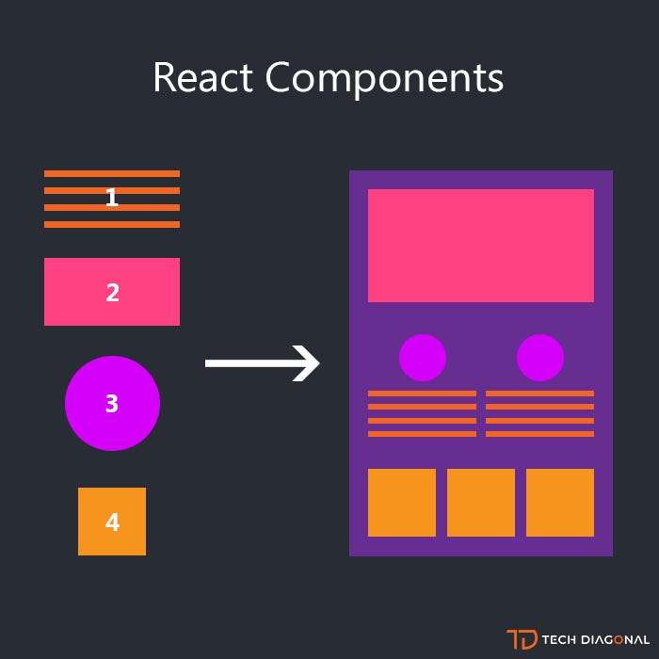

Slide 3
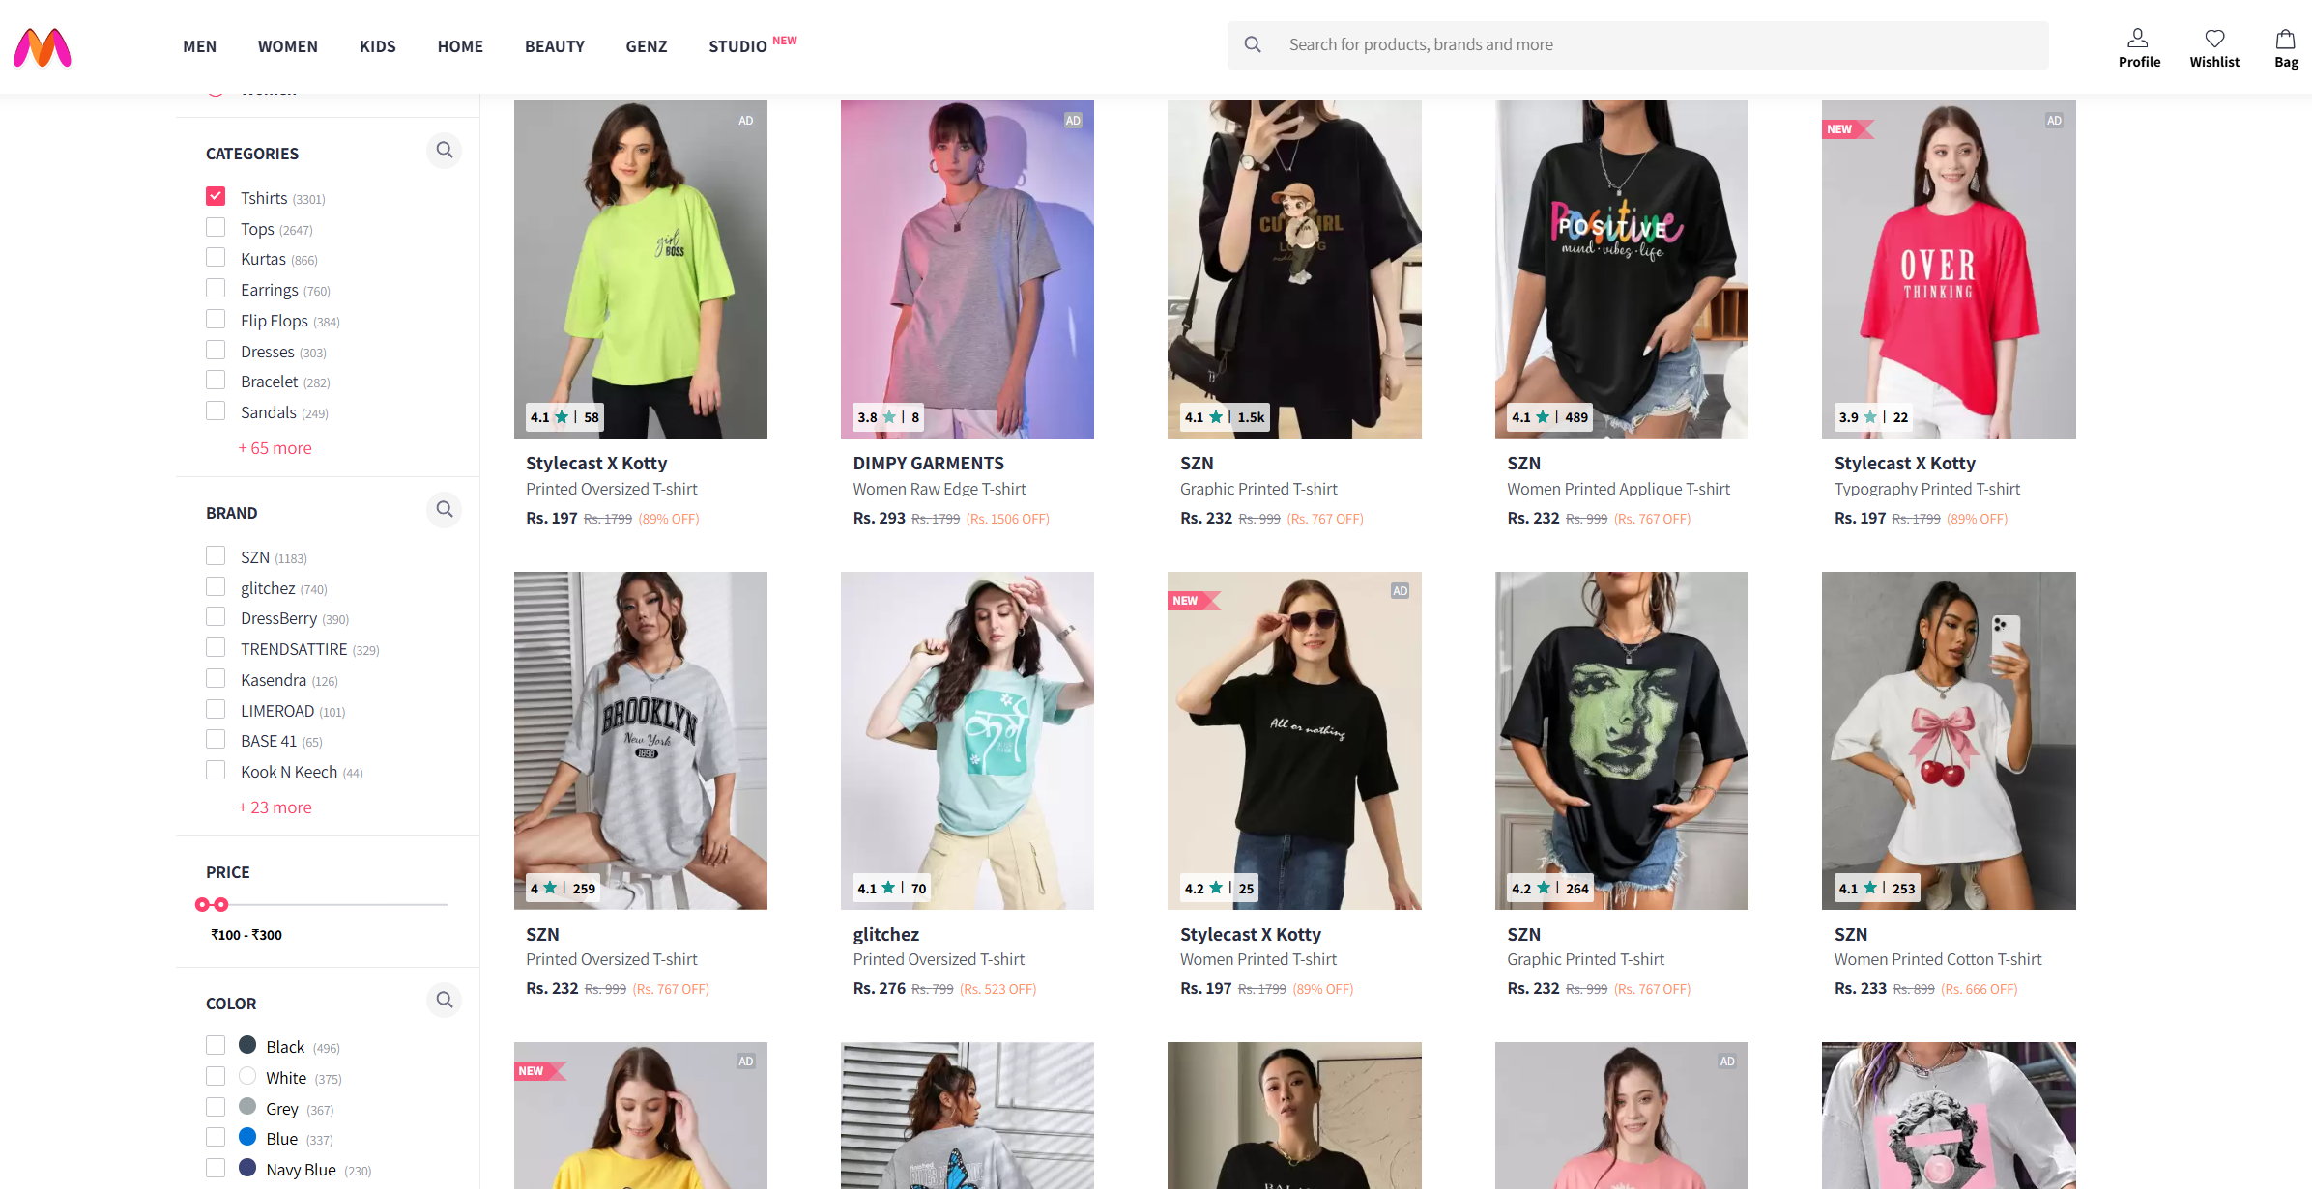

Slide 4
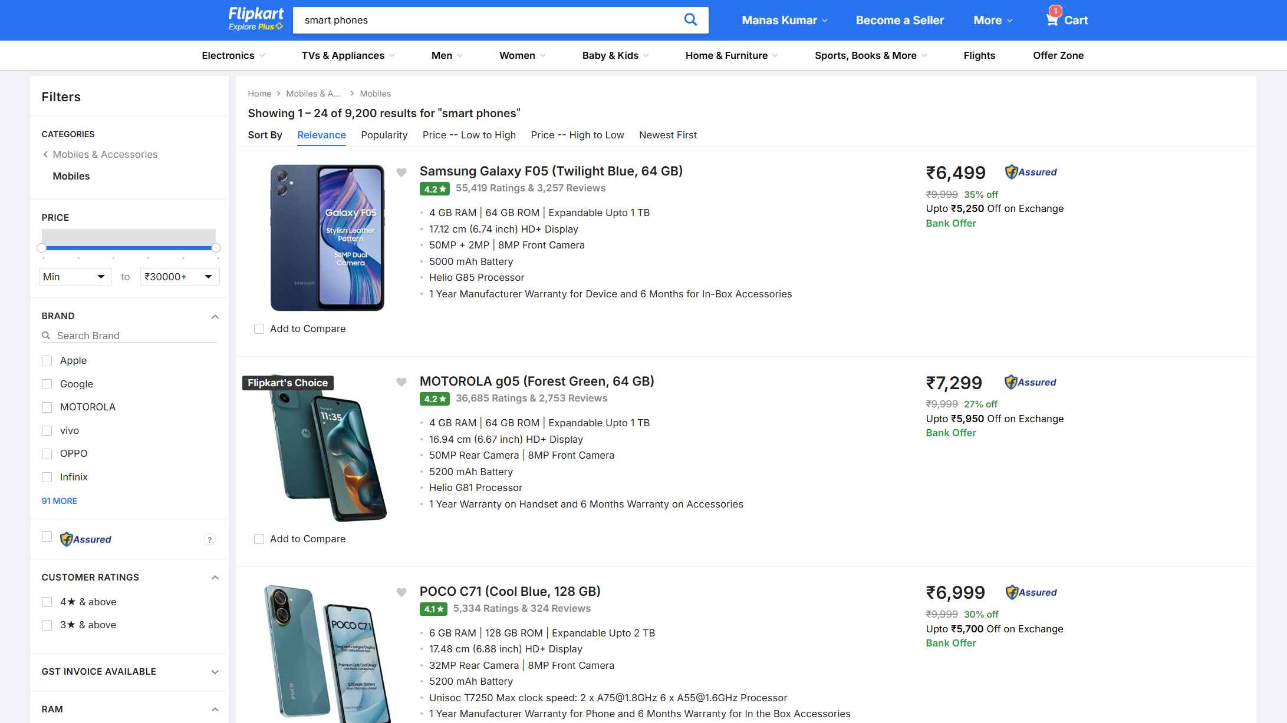

Slide 5
Types of Components
Functional Components (Preferred, modern way)
Class Components (Older, still important historically)

Slide 6
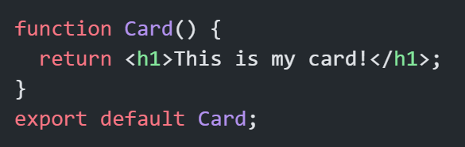
Functional Component
A function that returns JSX.
No need for this, simpler & cleaner.
With Hooks, functional components replaced most class components.

Slide 7
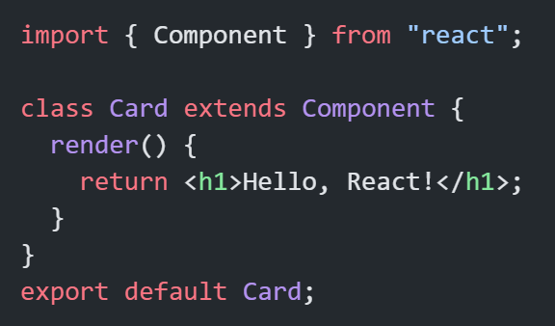
Class Component
Older style, before Hooks.
Uses render() method.
Still seen in legacy codebases.

Slide 8
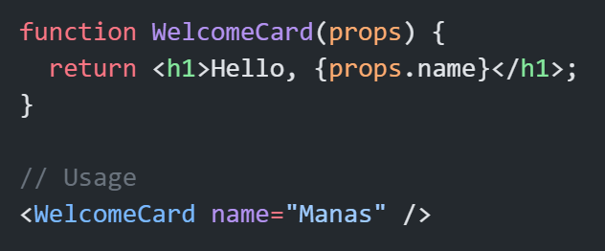
Props (Component Inputs)
Props = Properties
Passed from parent to child
Read-only (cannot be changed inside child)
Props make components dynamic & reusable.

Slide 9
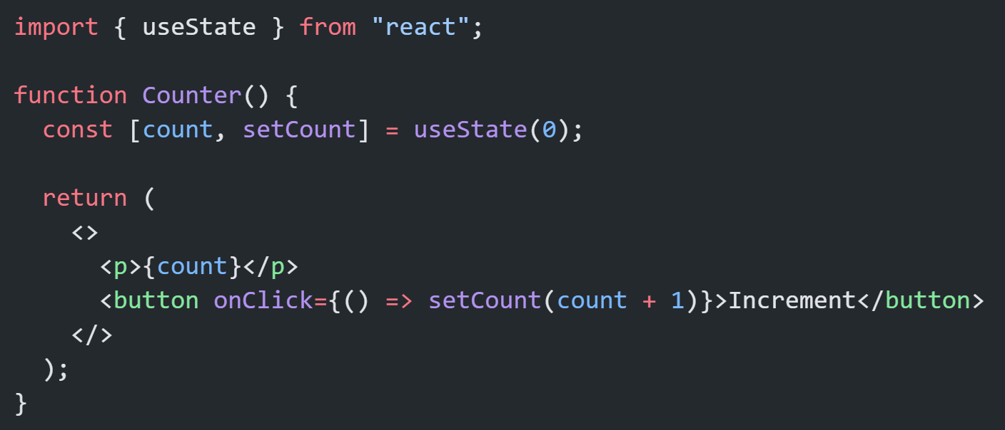
State (Component Memory)
State = Data that changes inside component
Managed with useState in functional components
Props = external input, State = internal memory.

Slide 10
Component Composition
Nesting components inside others
Makes UI modular
Small components combined → complex UIs.

Slide 11
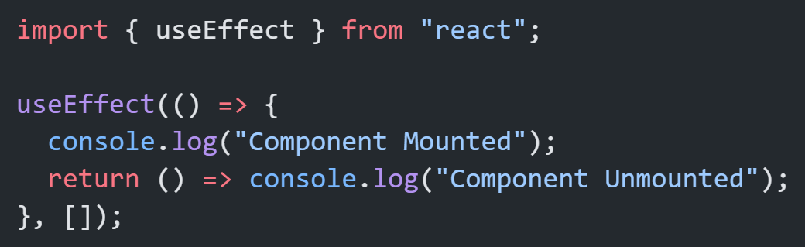
Component Lifecycle (Class vs Hooks)
Mounting → Updating → Unmounting
Class: componentDidMount, componentDidUpdate, componentWillUnmount
Function: useEffect hook

Slide 12
Advanced Component Patterns
Controlled vs Uncontrolled Components
Higher-Order Components (HOC)
Render Props
Compound Components
Custom Hooks
Notes:👉 Useful when scaling apps and managing complex UIs.

Slide 13
Best Practices
Keep components small & focused
Use PascalCase for component names
Reuse logic with custom hooks instead of duplicating
Separate UI (presentational) from business logic (container components)

Slide 14
Component v/s Functions
Aspect | JavaScript Function | React Component
Definition | A block of code that performs a specific task and returns a value. | A special function (or class) that returns JSX to describe UI.
Return Value | Returns primitive values, objects, arrays, or other functions. | Must return JSX (React elements) or null.
Naming Convention | Can be lowercase or uppercase (sum, addNumbers). | Must be PascalCase (Greeting, UserCard).
Input | Takes parameters/arguments. | Takes props as input.
Usage | Called directly like sum(2,3). | Used like an HTML tag: <Greeting name="Manas" />.
State Handling | Functions don’t have built-in memory/state. | Components can manage state with useState, useReducer, etc.
Reusability | Reusable logic, but not tied to UI. | Reusable UI + logic as building blocks.
Lifecycle | Functions don’t have lifecycle. | Components have lifecycle (mount, update, unmount).

Slide 15
Why Components?
Reusability → Write once, use anywhere
Maintainability → Code is easier to manage
Readability → UI is split into logical parts
Scalability → Large apps made manageable

Slide 16
Summary
Components = building blocks of React
Functional components are standard
Props = input, State = memory
Composition makes apps scalable
Lifecycle managed with Hooks
Advanced patterns → reusable, maintainable apps

